Slide 1

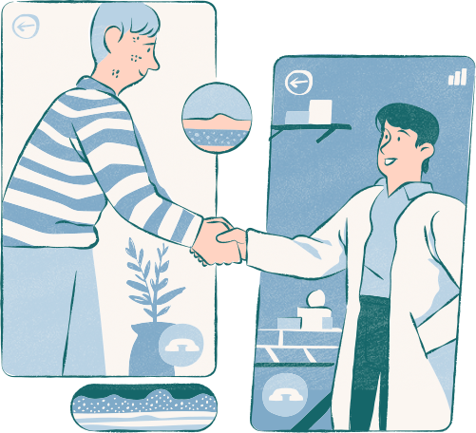
V-Medithon
HealthGuard:
A Multifunctional Healthcare Solution for Wearable Monitoring, Automated Tablet Dispensing, and AI-Driven Medical Consultation with Emergency Call Features
https://github.com/Amritha902/Medithon_HealthGuard

Slide 2

Introduction
Our goal in this project is to create an intelligent healthcare solution that integrates real-time health monitoring and medication management. By utilizing a tablet dispensing system, wearable devices, and AI/ML models, we aim to automate and personalize medical care. This system will track a patient’s vitals through wearable sensors, transmit this data to a cloud-based database (Firebase), and leverage it to dispense the right medication at the correct times. Through AI-powered analysis, we also aim to detect early symptoms of illnesses, such as cold and cough, and provide automated insights for healthcare providers. The overall objective is to enhance patient outcomes by providing an efficient, automated, and data-driven healthcare solution.

Slide 3
Real-Time Health Monitoring
Through wearable sensors, we aim to monitor vital signs like heart rate, temperature, and movement, ensuring constant and accurate health tracking.
Automated Tablet Dispensing
Our system automates the process of medication dispensing based on real-time health data and scheduled prescriptions, reducing human error.
01.
02.
Our Solution Approach
AI-Driven Disease Detection
By using AI/ML models, we can analyze health data and predict early signs of illnesses like cold and cough, providing timely alerts.
03.
Our healthcare system offers a comprehensive, data-driven approach to patient care, combining automation, AI, and cloud technology to improve health outcomes and streamline medical processes.
Enhanced Patient Care Efficiency
The solution improves healthcare delivery by automating repetitive tasks, enhancing decision-making with AI insights, and providing remote patient monitoring.
Cloud-Based Data Integration
With Firebase integration, patient health records are stored in the cloud, enabling easy access for healthcare providers and seamless synchronization across devices.
05.
04.

Slide 4
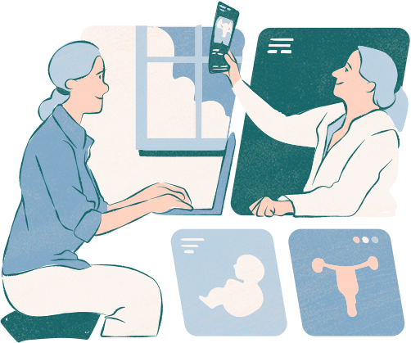
Real-Time Health Monitoring Integration:
The system uses wearable devices equipped with sensors to monitor patient vitals such as temperature, heart rate, and GSR. These sensors send real-time data to Firebase, where it’s stored and continuously updated. This ensures that patient health is always tracked and actionable information is available to adjust medication needs accordingly.

Slide 5
Automated Medication Dispensing:
The RTC (Real-Time Clock) module ensures that medications are dispensed at the correct times. A servo motor controls the rotation of a wheel containing different medication compartments. Based on the scheduled time and any abnormal health data (such as a fever), the system will release the appropriate tablet, ensuring precise and timely medication management.

Slide 6

Mobile App for User Interaction:
A Python-based mobile app allows users to input medication details, view upcoming medication schedules, and monitor health data. The app provides a simple and intuitive interface for both the patient and the caregiver to track and adjust medications while providing real-time updates on the patient's health.

Slide 7
AI-Enabled Diagnosis
An AI/ML model, processes real-time sensor data to detect possible health conditions such as a fever or cold. This AI-driven analysis helps diagnose patient conditions and automatically adjusts the medication if abnormal vitals are detected, enhancing personalized care.

Slide 8
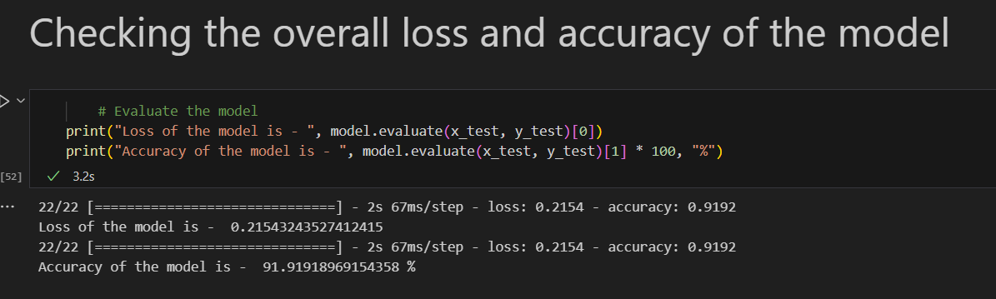
Our machine learning model achieves an impressive 91.92% accuracy with a low loss value of 0.2154, demonstrating strong reliability in predicting health outcomes. This level of accuracy is vital for patient safety and effective treatment. By incorporating this model into wearable devices and remote monitoring systems, we enhance health assessments and reduce misdiagnosis risks. We aim to further refine the model by integrating diverse data sources to continue improving healthcare analytics, supporting precise and timely care delivery.
91.92%
Success rate for our model

Slide 9
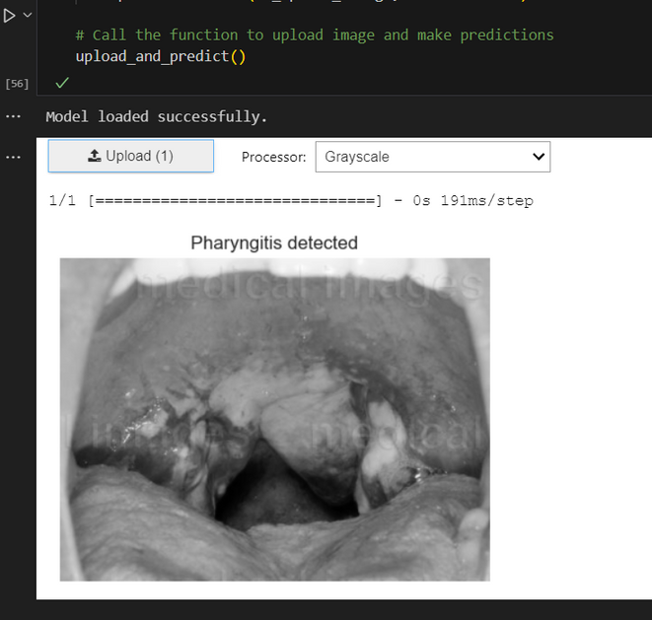
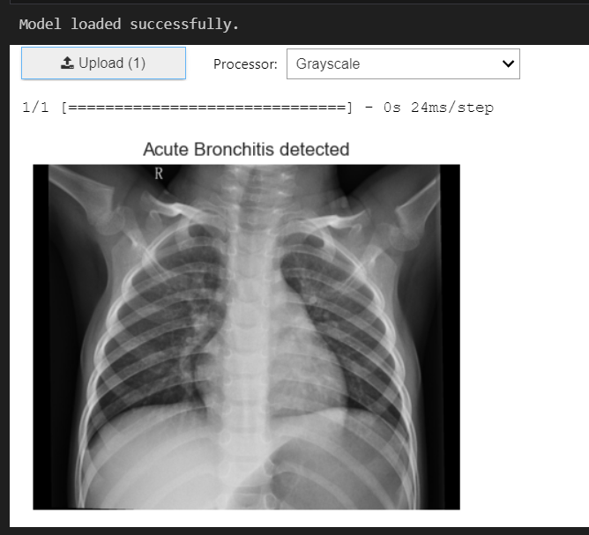
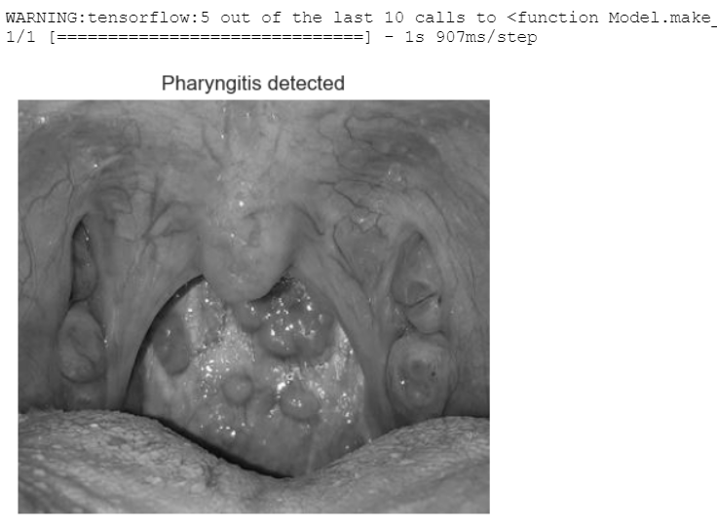
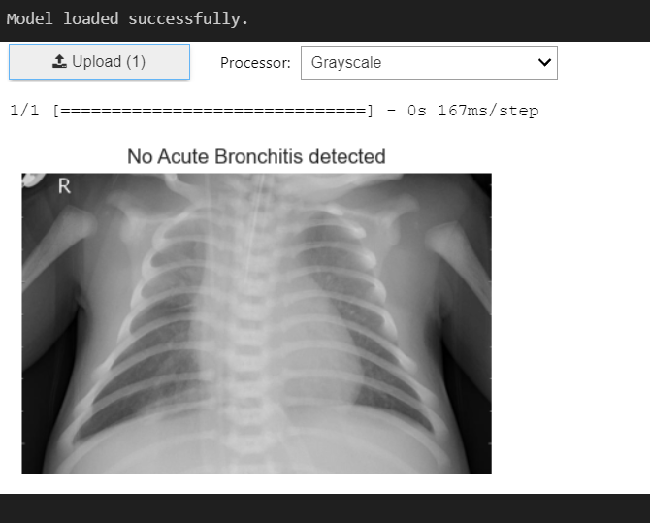
Some results of our model

Slide 10
Database Integration and Cloud Connectivity
The entire system integrates with Firebase, ensuring that health data, prescription schedules, and medication history are stored securely in the cloud. This data can also be synced with hospital databases, providing a comprehensive healthcare management solution, where doctors can monitor patient progress and adjust treatment as necessary.

Slide 11
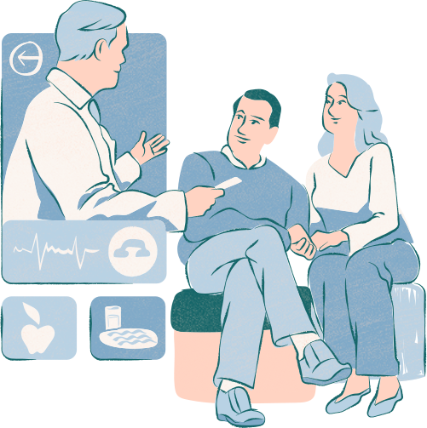
Wearable Health Monitoring System
Purpose: This component focuses on collecting real-time health data from patients through wearable sensors.
Key Functions:
Collect Sensor Data: Sensors measure vital signs such as heart rate, temperature, and GSR (Galvanic Skin Response).
Transmit Data: The collected data is sent wirelessly to a central database (Firebase) using the ESP8266 module.
Real-Time Monitoring: Enables continuous tracking of the patient's health, which can be accessed by other systems (like the kiosk).
Integration: The wearable's data serves as a primary input for health monitoring and emergency alerts, ensuring timely responses to patient conditions.

Slide 12

Tablet Dispensing System
Purpose: This system automates the dispensing of medication based on the patient’s prescriptions and health conditions.
Key Functions:
Check Prescription: Validates the medication against a doctor's prescription stored in Firebase.
Schedule Tablets: Utilizes a Real-Time Clock (RTC) to determine when to dispense medications, ensuring adherence to prescribed times.
Verify Conditions: Checks health data, such as body temperature, to adjust medication dispensing (e.g., adding fever medication when needed).
Integration: The dispenser operates based on inputs from both the wearable device and the database, ensuring that the right medication is administered at the right time.

Slide 13
Kiosk System with Health AI
Purpose: This component provides a user interface for patients to interact with their health data and get AI-based diagnoses.
Key Functions:
Receive Patient Data: Pulls health data from the wearable and Firebase.
Image Processing AI: Uses algorithms to analyze symptoms based on images (e.g., cough detection) to assist in diagnosing conditions like colds.
Suggest Treatment: Provides recommendations for treatment based on the AI analysis.
Integration: The kiosk communicates with the dispensing system to ensure that suggested treatments are aligned with the medications available for the patient.

Slide 14
Emergency and Critical Alert System
Purpose: Provides safety and emergency response capabilities.
Key Functions:
Monitor Vitals: Continuously checks critical health parameters.
Check for Critical Conditions: Evaluates whether vital signs indicate emergencies (e.g., high fever or abnormal heart rates).
Trigger Alerts: If a critical condition is detected, the system sends alerts to the patient, healthcare providers, and even calls an ambulance if necessary.
Integration: This system is interlinked with the wearable device and the kiosk to ensure prompt action is taken during emergencies, thereby enhancing patient safety.

Slide 15
Mobile App Interface
Purpose: Serves as the user-friendly interface for patients to manage their health and medications.
Key Functions:
User Login: Secure access to personal health data and prescription details.
Display Health Data: Shows real-time health metrics collected from the wearable.
Schedule Management: Allows users to view and manage their medication schedule.
Alerts: Notifies patients about critical health conditions or medication times.
Integration: The app connects to Firebase for real-time updates and alerts, enhancing patient adherence to medication schedules.
If users are not satisfied with AI suggestion then users can book an appointment in the nearby via the app

Slide 16
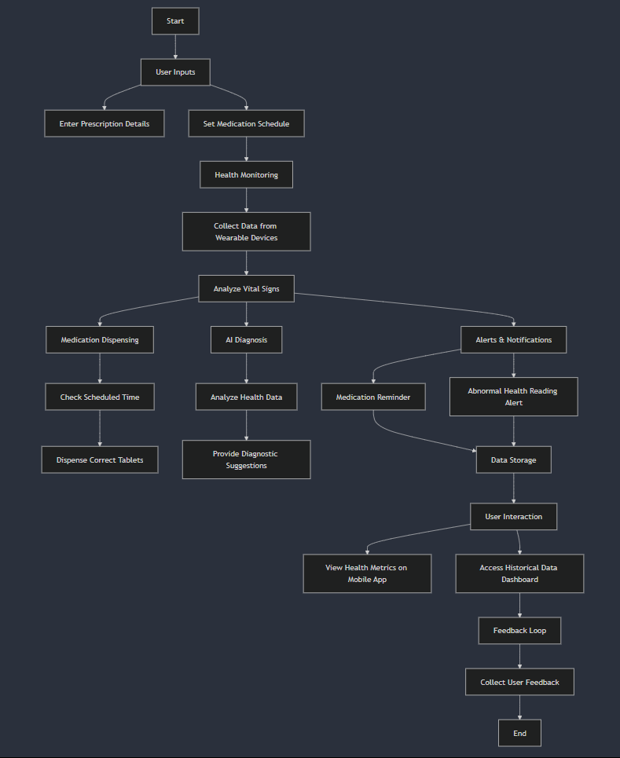
OUR FLOWCHART

Slide 17
Conclusion
The HealthGuard System integrates multiple healthcare functionalities into one solution, combining real-time health monitoring, AI-driven disease detection, and automated tablet dispensing, all managed through an easy-to-use mobile app. The system monitors vital signs through wearable sensors, dispenses medication accurately based on patient needs, and provides AI insights for diagnosing conditions like cold and cough. It enables patients, caregivers, and healthcare providers to stay informed and manage care more efficiently through real-time data and alerts.

Slide 18
AI Model Training for Additional Diseases:
Description: Expanding the system to train AI models for detecting other common diseases such as diabetes, hypertension, and respiratory illnesses.
Usefulness: This will enhance diagnostic capabilities, allowing for early detection and timely interventions, which can prevent complications and reduce hospital visits.
Teleconsultation Integration:
Description: Implementing a telemedicine feature within the app for remote consultations with healthcare professionals.
Usefulness: This will help patients receive immediate medical advice without the need to travel to a hospital, reducing congestion in healthcare facilities.
Enhanced Data Analytics:
Description: Utilizing advanced analytics to assess trends in patient health data over time.
Usefulness: This can provide valuable insights into individual and community health, helping healthcare providers make informed decisions and plan resources effectively.
Multi-Condition Support:
Description: Expanding the app's capabilities to manage multiple health conditions simultaneously.
Usefulness: This can cater to patients with comorbidities, ensuring comprehensive care and medication management.
Integration of Mental Health Monitoring:
Description: Incorporating features to monitor mental health indicators such as mood and stress levels.
Usefulness: Addressing mental health is crucial in holistic patient care, promoting overall well-being and reducing the need for emergency interventions.
Community Health Insights:
Description: Sharing anonymized health data trends with local health authorities to improve public health responses.
Usefulness: This can help in identifying outbreaks or health concerns within communities, facilitating timely interventions.
FUTURE ENHANCEMENTS

Slide 19
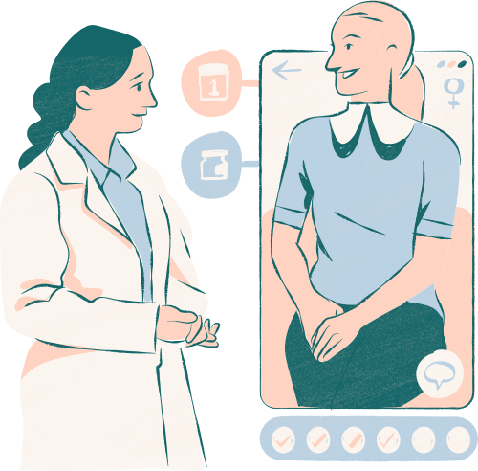
Thank you very much!
https://github.com/Amritha902/Medithon_HealthGuard

